Slide 1
Module 5

Slide 2
Module-5 Searching, Sorting and File Handling
Complexity of Algorithms, Searching - Linear and Binary search methods
Sorting - Bubble sort, Selection sort
Insertion sort
Quick sort, Comparative Study of the different Sorting Algorithms
File Handling: Text Files vs Binary Files, Modes of operation (Input and Output)
Handling Binary files
Streams, Standard I/O, Formatted I/O

Slide 3
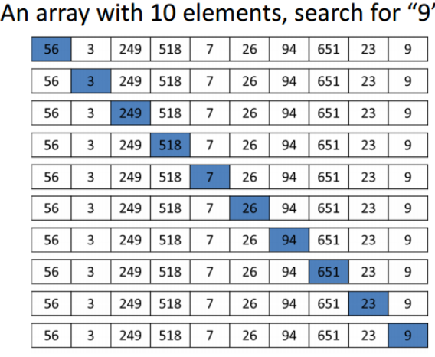
SEARCHING: linear search
Given an array arr[] of n elements, write a function to search a given element x in arr[]. A simple approach is to do linear search, i.e
Start from the leftmost element of arr[] and one by one compare x with each element of arr[]
If x matches with an element, return the index.
If x doesn’t match with any of elements, return -1.
Refer Program here

Slide 4
linear search
Linear search is rarely used practically because other search algorithms such as the binary search algorithm and hash tables allow significantly faster searching comparison to Linear search.
Performance
Number of comparisons made in searching a record determines the efficiency of the technique
The worst case efficiency of this algorithm is O(n)

Slide 5
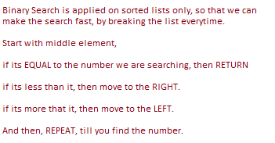
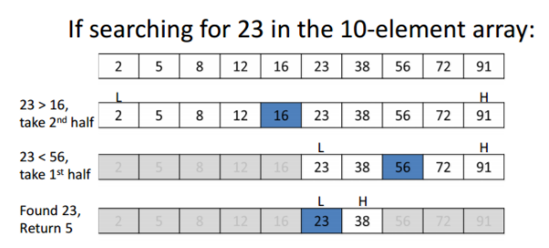
Binary search
Given a sorted array arr[] of n elements, write a function to search a given element item in arr[].
Binary Search
Refer program here

Slide 6
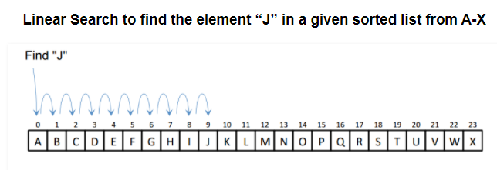
Linear Search vs Binary Search
Important Differences
Input data needs to be sorted in Binary Search and not in Linear Search
Linear search does the sequential access whereas Binary search access data randomly.
Time complexity of linear search O(n) , Binary search has time complexity O(log n).
Linear search performs equality comparisons and Binary search performs ordering comparisons
Notes:
how many times can you divide N by 2 until you have 1? This is essentially saying, do a binary search (half the elements) until you found it. In a formula this would be this:
1 = N / 2^{x}
multiply by 2^{x}:
2^{x} = N
now do the log₂:
log₂(2^{x}) = log₂ N x * log₂(2) = log₂ N x * 1 = log₂ N
this means you can divide log N times until you have everything divided. Which means you have to divide log N ("do the binary search step") until you found your element.

Slide 7
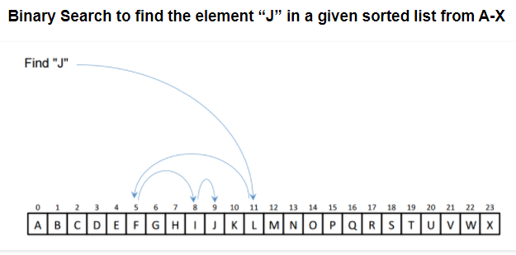
Linear Search vs Binary Search

Slide 8
Sorting
Sorting is the process of arranging the data in some logical order.
This logical order may be ascending or descending in case of numeric values or dictionary order in case of alphanumeric values.

Slide 9
Bubble sort
Bubble Sort is the simplest sorting algorithm that works by repeatedly swapping the adjacent elements if they are in wrong order.
Worst and Average Case Time Complexity: O(n*n). Worst case occurs when array is reverse sorted.
Best Case Time Complexity: O(n). Best case occurs when array is already sorted.
Due to its simplicity, bubble sort is often used to introduce the concept of a sorting algorithm. In computer graphics it is popular for its capability to detect a very small error (like swap of just two elements) in almost-sorted arrays and fix it with just linear complexity (2n). For example, it is used in a polygon filling algorithm, where bounding lines are sorted by their x coordinate at a specific scan line (a line parallel to x axis) and with incrementing y their order changes (two elements are swapped) only at intersections of two lines
Refer Program here

Slide 10
Modified bubble sort
Optimized Implementation: The above function always runs O(n^2) time even if the array is sorted. It can be optimized by stopping the algorithm if inner loop didn’t cause any swap.
Refer Program here

Slide 11
SELECTION SORT
The selection sort algorithm sorts an array by repeatedly finding the minimum element (considering ascending order) from unsorted part and putting it at the beginning. The algorithm maintains two subarrays in a given array.
1) The subarray which is already sorted. 2) Remaining subarray which is unsorted.
In every iteration of selection sort, the minimum element (considering ascending order) from the unsorted subarray is picked and moved to the sorted subarray.
Refer Program here

Slide 12
Insertion sort
It is a simple Sorting algorithm which sorts the array by shifting elements one by one. Following are some of the important characteristics of Insertion Sort.
It has one of the simplest implementation
It is efficient for smaller data sets, but very inefficient for larger lists.
Insertion Sort is adaptive, that means it reduces its total number of steps if given a partially sorted list, hence it increases its efficiency.
Refer Program here

Slide 13
FILE HANDLING
WHAT IS FILE?
A file is a collection of bytes stored on a secondary storage device(generally a disk)
Collection of byte may be interpreted as –
Single character
Single Word
Single Line
Complete Structure.
Data is stored onto the disk and can be retrieve whenever require.
In C we have many functions that deals with file handling
Advantage of File
It will contain the data even after program exit. Normally we use variable or array to store data, but data is lost after program exit. Variables and arrays are non-permanent storage medium whereas file is permanent storage medium.

Slide 14
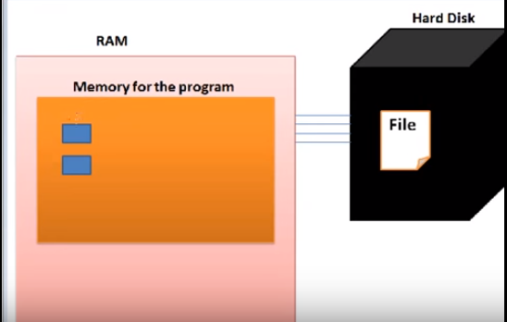
File handling-basics
.
3. Finally data can be stored from this variable
a
10
FILE
1. Reading file into RAM
File Pointer
2. Create a pointer which holds the address of first byte of the file
Notes:
Load file into the RAM (Also called opening of file)
How to access the file now? File is combination of bytes, every byte has an address. Address of first byte is stored in pointer.
Predefined functions are available which requires data to be stored and its location

Slide 15
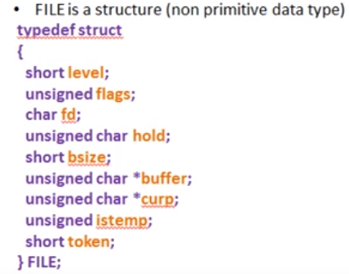
File handling- basics
In stdio.h header file FILE structure is defined
FILE structure provides us the necessary information about a FILE or stream which performs input and output operations
FILE *fp
FILE
level
flags
fd
hold
bsize
istemp
token
*curp
*buffer
<structure: used to describe a file>

Slide 16
Writing data to file
File Pointer
fp
f1.txt
level
flags
fd
INPUT BUFFER
hold
bsize
istemp
1. Open file: Reading file into RAM
token
*curp
*buffer
Notes:
First of all, we all should know that while doing any operation on a file in C, we are not working on the actual file. What happens is that the contents of the file we want to perform, are copied in a memory buffer. and whenever we execute the above two statements, a structure as defined above is created, its elements are setup for the file referred and the base addresss of this srtucture is returned in pointer 'fp'. Thus, fp is not pointing to the file's buffer. Within the structure to which fp is pointing, there is a character pointer called 'buffer'(refer to the structure). It is this pointer which points to the file's buffer. It can be explained like this: address of structure=1500 => address stored in fp=1500 address of file buffer=1700 => address stored in 'char *buffer'=1700

Slide 17
C file operations
C File Operations
There are five major operations that can be performed on a file are:
Creation of a new file.
Opening an existing file.
Reading data from a file.
Writing data in a file.
Closing a file.
Steps for Processing a File
Declare a file pointer variable.
Open a file using fopen() function.
Process the file using suitable function.
Close the file using fclose() function.

Slide 18
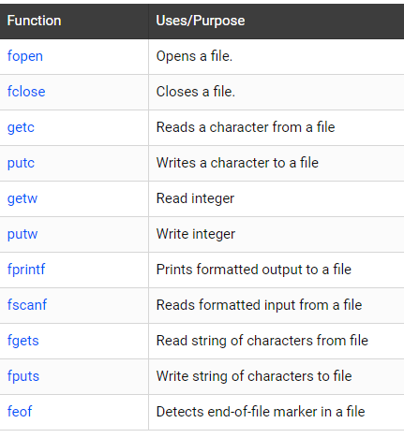
To handle files in C, file input/output functions available in the stdio library are:

Slide 19
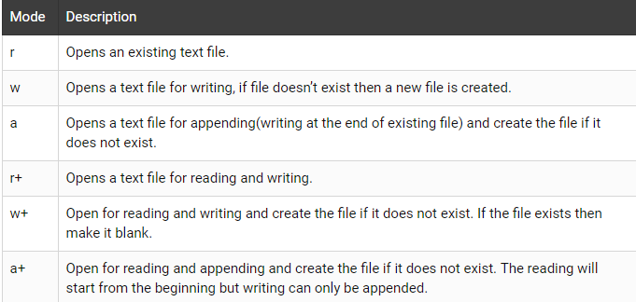
C file operations
1. C fopen function is used to open existing file or create a new file.
Parameters
The first argument is a pointer to a string containing name of the file to be opened.
mode: The second argument is a access mode

Slide 20
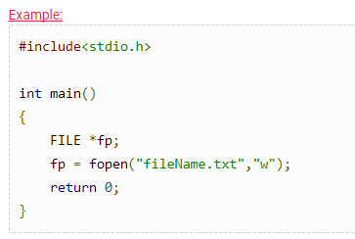
C file operations
Return Value
C fopen function returns NULL in case of a failure, and returns a FILE stream pointer on success.
The above example will create a file called fileName.txt.
The w means that the file is being opened for writing, and if the file does not exist then new file will be created.
fp – file pointer to the data type “FILE”.

Slide 21

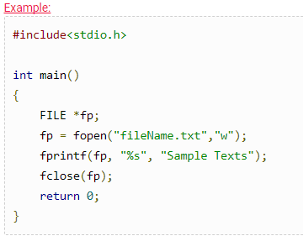
C file operations
2. fclose() function is C library function and it’s used to releases the memory stream, opened by fopen() function.
Return Value
C fclose returns EOF in case of failure, and
returns 0 on success
Notes:
if buffer is not full but data is written on it then we can forcefully write data on the file using fclose function
//if buffer is full, data is written to the file automatically

Slide 22

C file operations
The above example will create a file called fileName.txt.
The w means that the file is being opened for writing, and if the file does not exist then new file will be created.
The fprintf function writes Sample Texts text on the file.
The fclose function closes the file and releases the memory stream.
3. getc() function is C library function and it’s used to read a character from a file that has been opened in read mode by fopen() function.

Slide 23
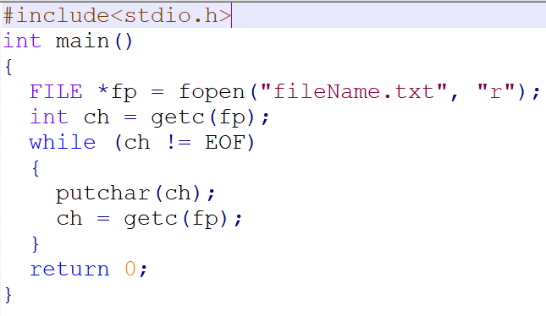


C file operations
4. putc() function is C library function and it’s used to write a character to the file.

Slide 24

C file operations
5) fprintf() function is used to write formatted data into a file. In a C program, we use fprinf() as below. fprintf (fp, “%s %d”, var1, var2);
Where, fp is file pointer to the data type “FILE”. var1 – string variable var2 – Integer variable

Slide 25

C file operations
Note
6. fscanf: C fscanf function reads formatted input from a file.
stream − This is the pointer to a FILE object that identifies the stream.
format − This is the C string that contains one or more of the following items − Whitespace character, Non-whitespace character and Format specifiers.
Note: If we need to store records in the binary format, then we must use fwrite function to write the record to a file and fread to read information back from the file.
Refer Program to understand fprintf and fscanf function
Notes:
http://www.csegeek.com/csegeek/view/tutorials/c_lang/c_file.php

Slide 26
Types of file
There are 2 kinds of files in which data can be stored in 2 ways either in characters coded in their ASCII character set or in binary format. They are
Text Files.
Binary Files
TEXT FILES
Text files are the normal .txt files that you can easily create using Notepad or any simple text editors.
When you open those files, you'll see all the contents within the file as plain text. You can easily edit or delete the contents.
They take minimum effort to maintain, are easily readable, and provide least security and takes bigger storage space.
BINARY FILES
Binary files are mostly the .bin files in your computer.
Instead of storing data in plain text, they store it in the binary form (0's and 1's).
They can hold higher amount of data, are not readable easily and provides a better security than text files.

Slide 27
Handling Binary files
Opening a file - for creation and edit
Opening a file is performed using the library function in the "stdio.h" header file: fopen().
The syntax for opening a file in standard I/O is:
ptr = fopen("fileopen","mode")
For Example:
fopen("E:\\cprogram\\newprogram.txt","w"); //write data in text file
fopen("E:\\cprogram\\oldprogram.bin","rb"); //write data in binary file

Slide 28
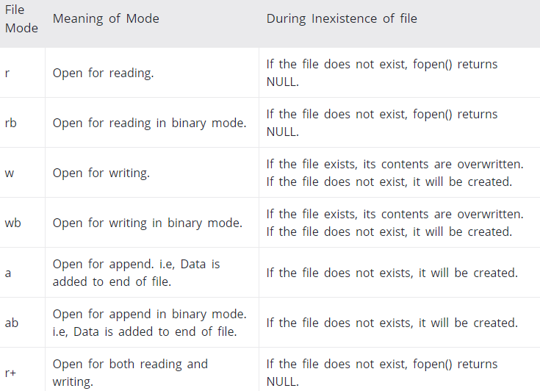

Slide 29
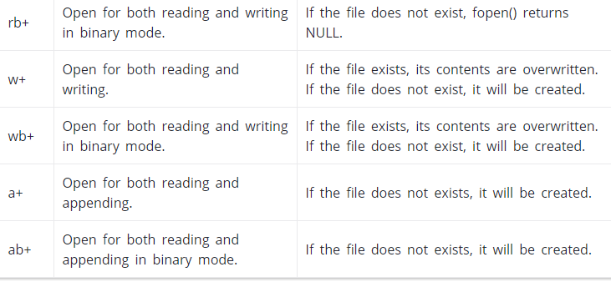

Slide 30
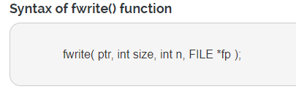
Handling Binary files
1. fwrite() function
The fwrite() function is used to write records (sequence of bytes) to the file. A record may be an array or a structure.
The fwrite() function takes four arguments. ptr : ptr is the reference of an array or a structure stored in memory. size : size is the total number of bytes to be written. n : n is number of times a record will be written. FILE* : FILE* is a file where the records will be written in binary mode.

Slide 31
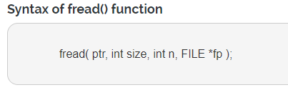
Handling Binary files
2. fread() function
The fread() function is used to read bytes form the file.
The fread() function takes four arguments. ptr : ptr is the reference of an array or a structure where data will be stored after reading. size : size is the total number of bytes to be read from file. n : n is number of times a record will be read. FILE* : FILE* is a file where the records will be read.
Refer Program to understand fwrite and fread function

